Slide 1

CPU SCHEDULING ALGORITHM SIMULATION
SRM INSTITUTE OF SCIENCE AND TECHNOLOGY
COLLEGE OF ENGINEERING AND TECHNOLOGY
DEPARTMENT OF NETWORKING AND COMMUNICATIONS
21CSC202J-Operating Systems , Mini-Project Presentation
TUMATI OMKAR CHOWDARY
Reg No:RA2211026010188
THOTAMSETTY CHATUSH RAJ
Reg No:RA2211026010153
Batch ID:2
Guide name and Designation: Dr. S. Vimal(Assistant Professor)

Slide 2
Table of contents

Slide 3
Objective
Problem Statement
Architecture/ Flow chart
Hardware/Software requirements
Implementation- Code snippet
Results- Screen Shots of Output
Conclusion

Slide 4
OBJECTIVE:

Slide 5

Objective
The objective of the CPU scheduling algorithm simulation project is to develop a Java-based software application that models, analyzes, and visualizes the behavior of different CPU scheduling algorithms within the context of operating systems. This project serves to facilitate an in-depth understanding of CPU scheduling strategies, enable their comparison, and support experimentation with various scheduling techniques.
Specifically, the project aims to achieve the following objectives:
1. Algorithm Comparison: Implement and assess the performance of multiple CPU scheduling algorithms, including Round Robin, Shortest Job First, and Priority Scheduling.
2. Performance Metrics: Measure and analyze the performance of these algorithms using key benchmarks, such as CPU utilization, response time, and throughput.
3. Efficiency Determination: Utilize the results of the analysis to identify the most efficient CPU scheduling algorithm for the system under examination.

Slide 6
ABSTRACT:

Slide 7
The CPU scheduling algorithm simulation project is a Java-based software application designed to model, analyze, and visualize the behavior of various CPU scheduling algorithms in the context of operating systems. CPU scheduling is a fundamental component of modern computer systems, responsible for efficiently allocating processor time to multiple processes. This project aims to provide a platform for understanding, comparing, and experimenting with different CPU scheduling strategies.
This project aims to compare the performance of different CPU scheduling algorithms and analyze the results to determine the best algorithm for a system. The project will involve the implementation of various scheduling algorithms, including Round Robin, Shortest Job First, and Priority Scheduling, and the measurement of their performance using benchmarks such as CPU utilization, response time, and throughput. The results of the analysis will be used to determine the most efficient algorithm for the system being studied.

Slide 8
PROBLEM STATEMENT:

Slide 9
The “CPU Scheduling Algorithm Simulation” in Java offers a comprehensive and interactive platform for students, researchers, and anyone interested in learning about or researching CPU scheduling algorithms. By providing a practical tool for algorithm exploration and performance analysis, this project contributes to a better understanding of the critical role scheduling plays in optimizing the use of CPU resources.
Efficient CPU resource management is critical in modern computer systems. CPU scheduling algorithms are pivotal in ensuring fair process execution. Our project, "CPU Scheduling Algorithm Simulation in Java," offers a hands-on exploration of these strategies. It models and simulates popular algorithms, from FCFS to Round Robin, enabling users to define processes, visualize execution, and analyze performance metrics. Designed for educational and research purposes, it's a valuable resource for students and researchers. Our project fosters a practical understanding of scheduling's impact on system performance and responsiveness, contributing to better-informed decisions for optimizing CPU resource allocation.

Slide 10
MOTIVATION

Slide 11
1. Foundational Knowledge: Understanding CPU scheduling is fundamental for working with computers and operating systems.
2. Real-World Impact: Efficient scheduling directly influences system performance, making it crucial in professional contexts.
3. Interactive Learning: The project offers hands-on experience, simplifying complex concepts in scheduling algorithms.
4. Educational Enhancement: It complements academic studies, better preparing students for careers in computer science and IT.
5. Problem-Solving Skills: Users develop skills to evaluate trade-offs and optimize system performance.
6. Research and Innovation: It serves as a platform for researchers to experiment with and innovate in scheduling strategies.
7. Career Advancement: Proficiency in CPU scheduling enhances career opportunities in the IT industry.
8. Informed Decision-Making: Whether student or professional, it empowers users to make informed system management decisions.
9. Multidisciplinary Relevance: The knowledge extends to fields requiring efficient resource allocation beyond computer science.

Slide 12
The motivation for this project lies in the critical importance of CPU scheduling in computer systems. Understanding CPU scheduling is foundational for anyone working with computers, as it directly influences system performance and responsiveness. This project offers an interactive learning experience, making complex scheduling algorithms accessible and engaging for learners. It complements academic studies, providing students with practical skills that prepare them for careers in computer science and IT. Users also gain problem-solving proficiency and the ability to critically assess scheduling algorithms, allowing for optimized system performance. Furthermore, researchers can utilize the project to experiment and innovate in scheduling strategies, and proficiency in CPU scheduling enhances career prospects in the IT industry. This knowledge extends beyond computer science, finding relevance in various fields requiring efficient resource allocation. Additionally, it encourages community collaboration and knowledge sharing, facilitating collective advancement in the field.

Slide 13

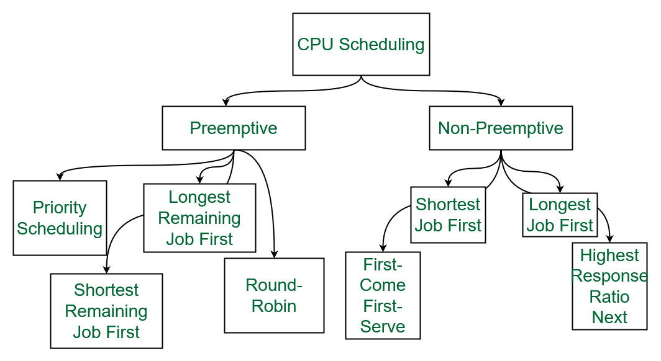
Algorithms Implemented
FCFS
Shortest Job First
Round Robin
Priority Scheduling

Slide 14
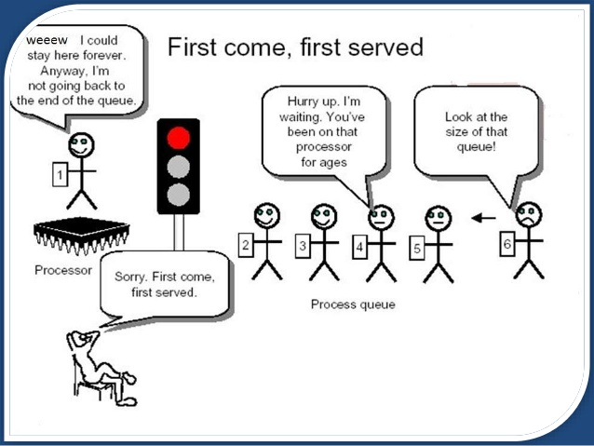
First Come First Serve [FCFS]
First-Come-First-Serve (FCFS) is one of the simplest CPU scheduling algorithms. In FCFS, processes are executed in the order they arrive in the ready queue. The first process to arrive is the first to be served, hence the name. FCFS operates on the principle of fairness, as it ensures that every process gets a chance to execute. However, it can lead to inefficiency, especially if a long-running process arrives first, causing subsequent processes to wait extensively. This scenario is known as the "convoy effect." FCFS is non-preemptive, meaning a process continues to execute until it completes or voluntarily yields the CPU

Slide 15

Shortest Job First
[SJF]
Shortest Job First (SJF) is a CPU scheduling algorithm that prioritizes processes with the shortest burst times, ensuring that the process requiring the least amount of CPU time is executed first. SJF is a preemptive algorithm, meaning that if a new process with a shorter burst time arrives while another process is running, the currently executing process is interrupted to allow the shorter one to execute. This minimizes the average waiting time and optimizes system throughput. However, predicting the exact burst time of a process can be challenging, and inaccurate estimations may lead to frequent preemptions, resulting in increased context switching and potential overhead.

Slide 16

Round Robin
Round Robin (RR) is a CPU scheduling algorithm designed to provide fair and balanced execution of processes in a time-sharing manner. In RR, each process is assigned a fixed time quantum, and the CPU executes each process for the duration of one time quantum. If a process does not complete within its time quantum, it is preempted, and the CPU moves on to the next process in the queue. This cycle continues until all processes have had a chance to execute.
Round Robin is a preemptive scheduling algorithm, and it is particularly suitable for scenarios where processes have similar time requirements or need equal access to the CPU. RR ensures that no single process monopolizes the CPU for an extended period, which is essential for maintaining system responsiveness. However, it may not be the most efficient choice for processes with varying execution times, as shorter processes might have to wait until their time quantum comes up again.

Slide 17

Priority Scheduling
Priority Scheduling is a CPU scheduling algorithm that assigns priorities to processes based on certain criteria, such as process importance, task type, or any other relevant parameter. In this scheme, processes with higher priority values are executed before those with lower priority values. Priority scheduling can be either preemptive or non-preemptive, depending on whether higher-priority processes can interrupt lower-priority ones while they are running.
In preemptive priority scheduling, the system may interrupt a lower-priority process when a higher-priority process becomes available, ensuring that critical tasks are addressed promptly. In contrast, non-preemptive priority scheduling allows a process to run to completion before the CPU is allocated to a higher-priority task.

Slide 18
ARCHITECRURE / FLOWCHART:

Slide 19
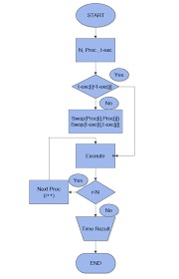
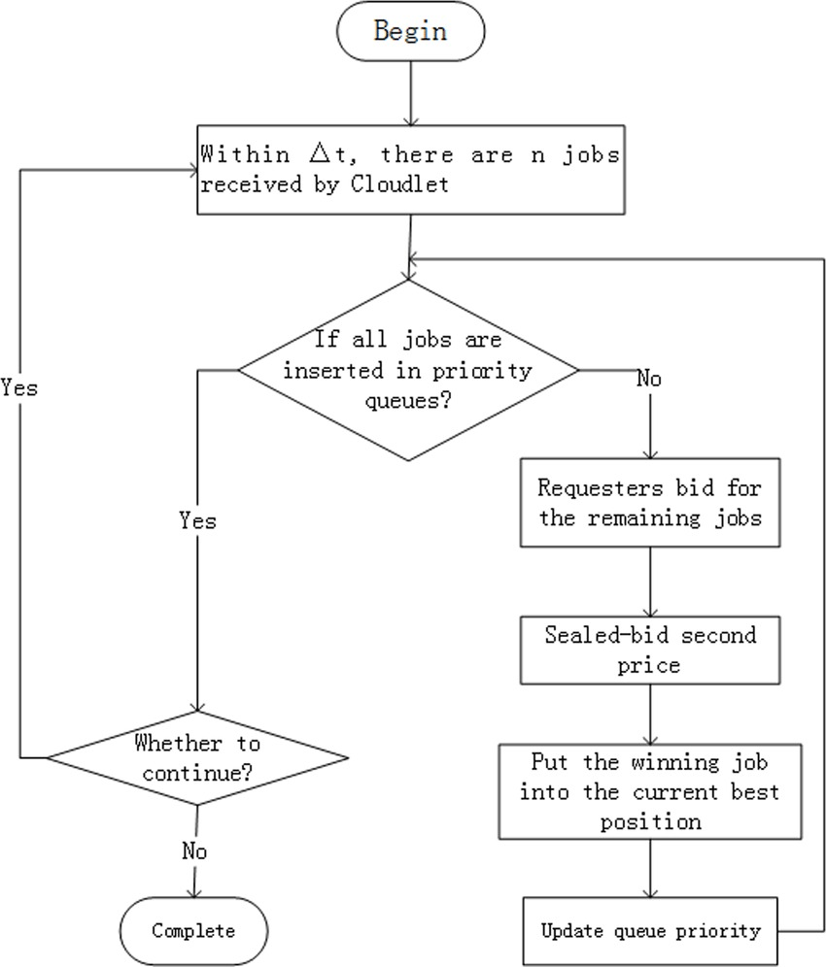
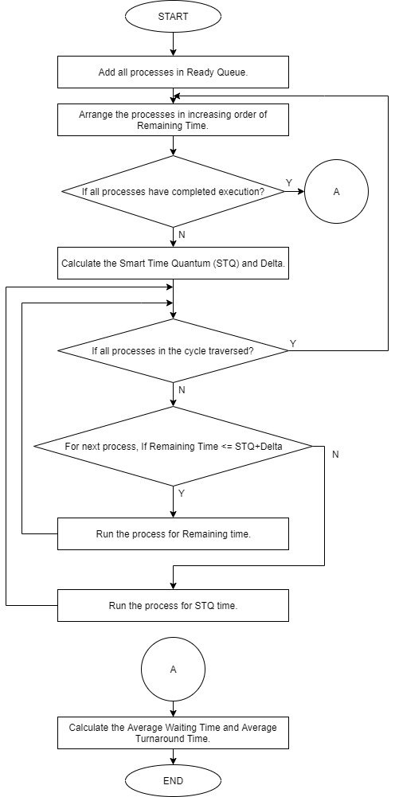
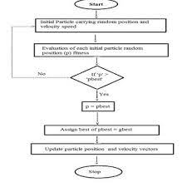
ROUND ROBIN
FCFS
SJF
PRIORITY

Slide 20
IMPLEMENTATION:

Slide 21

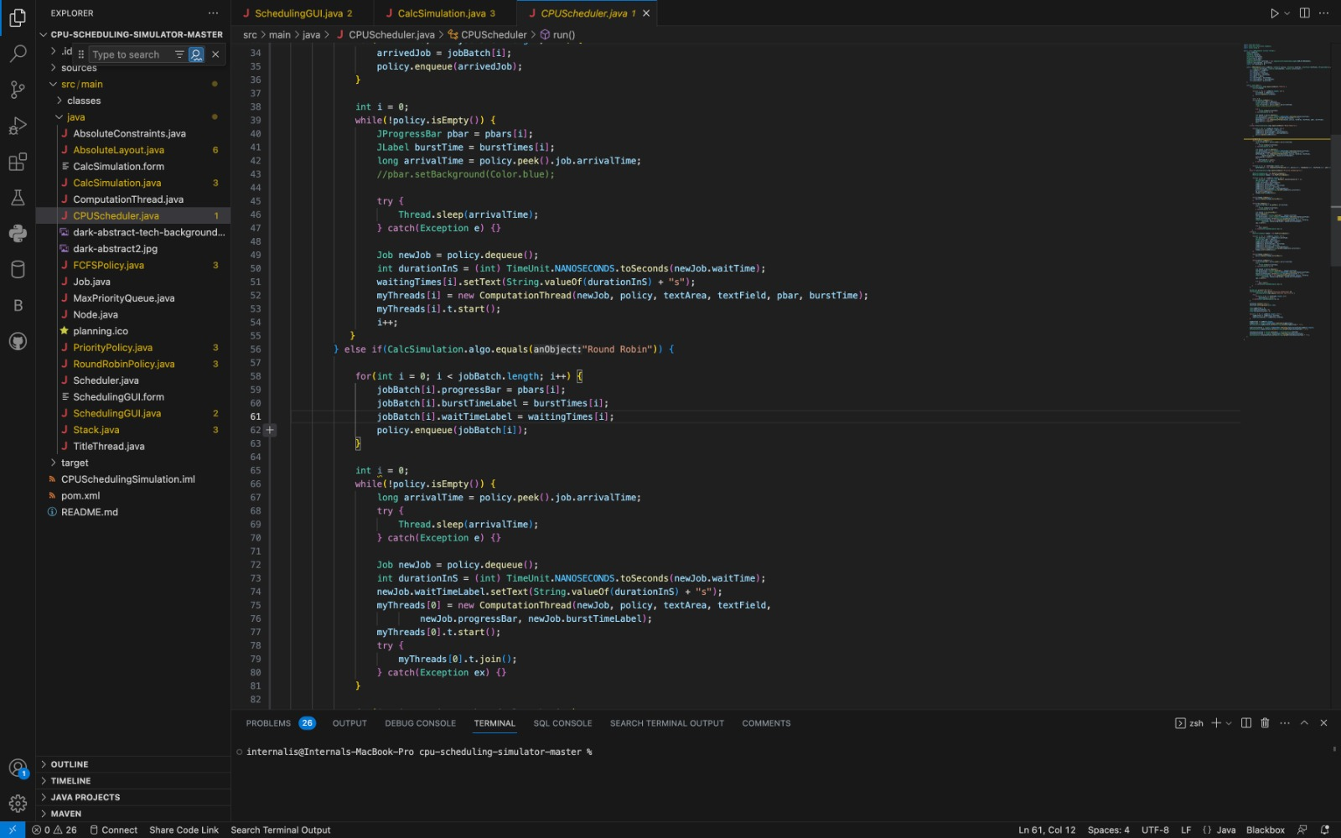
Implementation- Code snippet
Front end:
1.Java swing
2.Java AWT
Back end:
Java

Slide 22
DEMONSTRATION

Slide 23
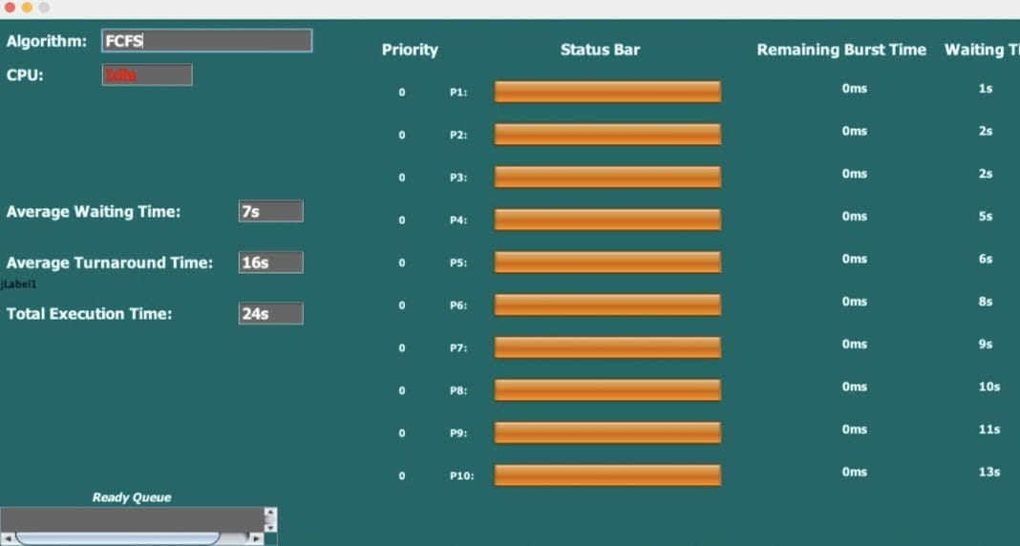
First Come First Serve [FCFS]

Slide 24
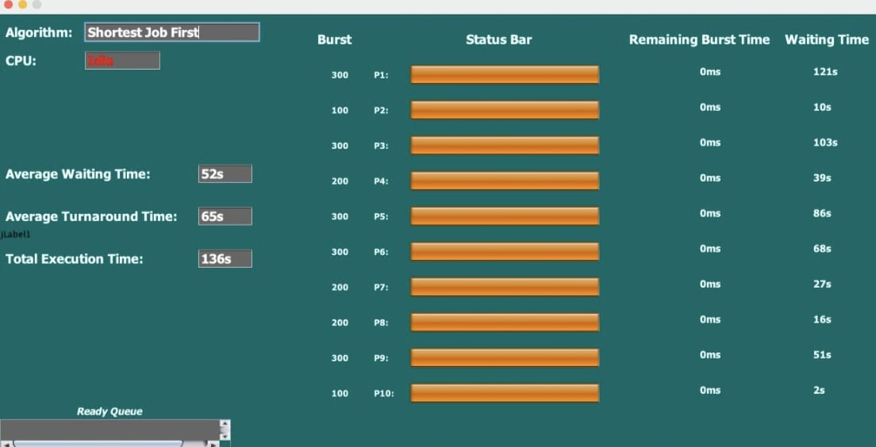
Shortest Job First
[SJF]

Slide 25
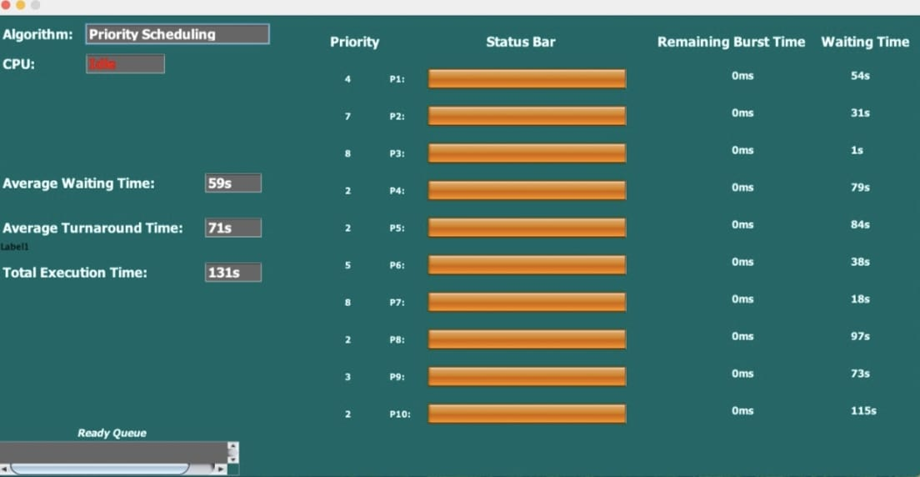
Priority Scheduling

Slide 26
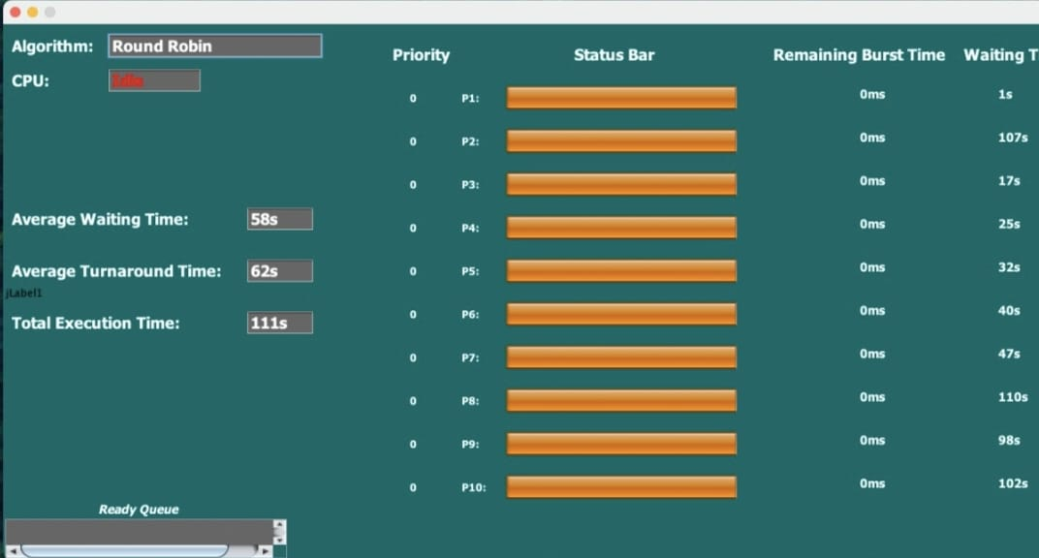
Round Robin

Slide 27
Output Comparison:
FCFS
SJB
Priority Scheduling
Round Robin

Slide 28
THANK YOU

